Slide 1

Olympic Games Dashboard
Insights on Global Participation, Performance & Trends

Slide 2
Olympic Dashboard Insights Overview
Valuable Insights
The Power BI dashboard built on the Olympic dataset provides valuable insights into global sports participation and medal performance. It highlights athlete contributions, top-performing countries, and sport-specific medal trends, enabling stakeholders to understand regional strengths, medal efficiency, and historical performance across different Olympic editions.
Improvement Focus
The dashboard reveals areas for refinement, such as incomplete athlete details and inconsistencies in city-event mappings. These insights help improve data accuracy and promote cleaner reporting. Enhancing data granularity and completeness would empower deeper, more reliable analysis across all dimensions.
Evaluation of Effectiveness
The dashboard evaluates the effectiveness of regional participation, medal-to-athlete ratios, and country-wise performance. By comparing medals against sports and athlete count, it helps measure competitive efficiency, spotlighting the impact of strategic investments in certain disciplines and seasons.
Trend Identification
Using historical participation and medal data, the dashboard identifies trends across countries, sports, and decades. It captures rising gender balance, shifting sport popularity, and host city repetition. Such trend visibility aids planning for national committees and sponsors looking to optimize future participation.
Comprehensive Understanding
This Power BI report unifies athlete demographics, sports, medals, and geography into one platform. It offers a holistic view of Olympic evolution, making it easier for analysts, educators, or policymakers to study athlete development, country-wise trends, and sport-level dynamics with clarity and precision.

Slide 3
Project Details and Strategic Value
Analytical Scope
The analysis includes athlete demographics, sport-wise events, medal trends by gender, season, region, and Olympic year, helping identify performance patterns, efficiency, and global participation shifts over time.
Project Goal
To provide a centralized, user-friendly tool for stakeholders to evaluate Olympic trends, compare country performance, and support planning, training, and investment decisions using historical and sport-specific insights.
Data Sources
Derived from a structured Olympic dataset with multiple dimension tables joined into a single fact table, enabling efficient reporting, rich filtering, and comprehensive exploration of historical Olympic data.
Target Audience
Designed for analysts, Olympic committees, educators, and policymakers who seek to explore performance trends, identify strategic opportunities, and promote equity in sports through data.
Business/Strategic Impact
Empowers decision-makers with data on medal efficiency, participation diversity, and sport development trends, guiding investment, training focus, and global sports collaboration strategies for long-term impact.

Slide 4
Data Overview
Data Description
Meta Data
Column Name | Data Type | Description
athlete_id | Integer | Unique identifier for each athlete
full_name | Text | Full name of the athlete
gender | Text | Gender of the athlete (Male/Female)
age | Integer | Age of the athlete at the time of participation
height | Decimal | Height of the athlete in centimeters
weight | Decimal | Weight of the athlete in kilograms
region_name | Text | Name of the region or country represented
noc_region | Text | NOC (National Olympic Committee) code
games_name | Text | Official name of the Olympic Games (e.g., 2008 Summer)
games_year | Integer | Year in which the Olympic Games were held
season | Text | Season of the games (Summer/Winter)
city_name | Text | Host city of the Olympic Games
sport_name | Text | Name of the sport in which the event was held
event_name | Text | Specific event under a sport
medal_name | Text | Type of medal awarded (Gold, Silver, Bronze, NA if no medal
Item | Details
Source | Compiled from structured normalized tables and merged into a fact table
Time Span | Covers all Olympic Games from 1896 to 2016
Data Granularity | One row per athlete per event per Olympic Games
Primary Key | Composite (athlete_id + games_year + event_name)
Fact Table | Fact_Olympic
Dimension Tables Merged | person, games, event, sport, region, medal, city
Tool Used | Power BI (with Power Query for transformations and merging)
Use Case | Performance evaluation, medal trends, gender analysis, and Olympic history

Slide 5

ER Diagram

Slide 6
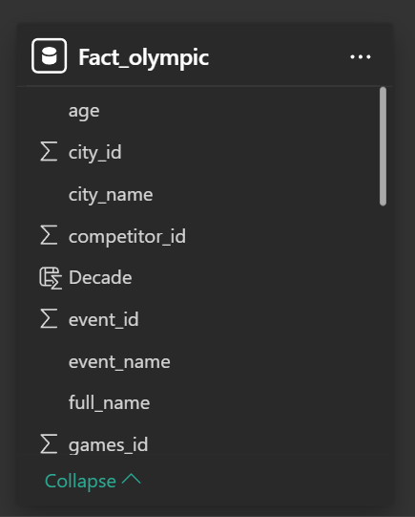
Fact Table Olympic Data Set

Slide 7
Power Bi Dashboard

Slide 8
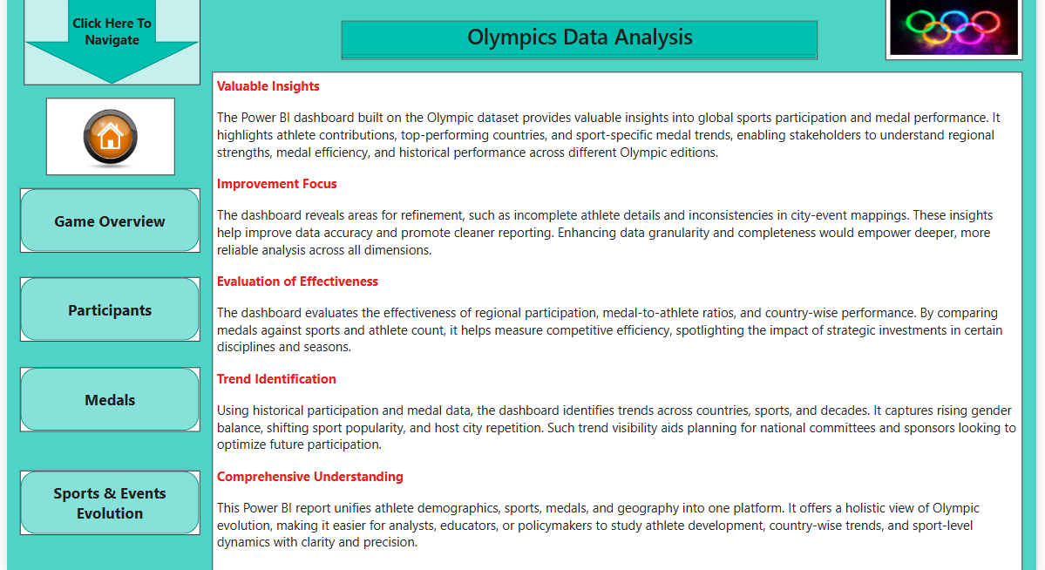

Slide 9
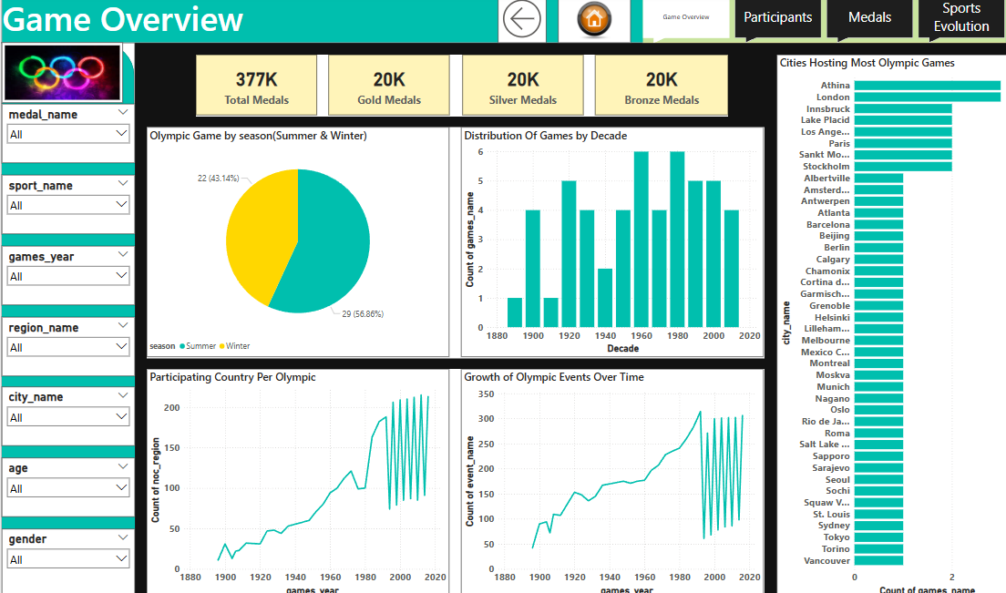

Slide 10
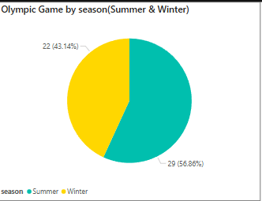
How many Olympic Games have been held in each season (Summer vs. Winter)?
Conclusion : The Summer Olympics have been held more frequently than Winter Games, reflecting greater global participation and sport diversity. This dominance is driven by the broader scope of Summer sports, higher athlete turnout, and stronger historical continuity, despite occasional cancellations during world events.

Slide 11
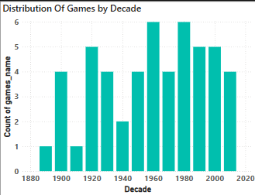
What is the distribution of games across different decades?
Conclusion : Olympic Games have become more consistent and frequent over the decades, with noticeable disruptions during World Wars. The overall upward trend highlights the growing importance of the Olympics as a global event, supported by better infrastructure, international cooperation, and increased participation from emerging nations.

Slide 12
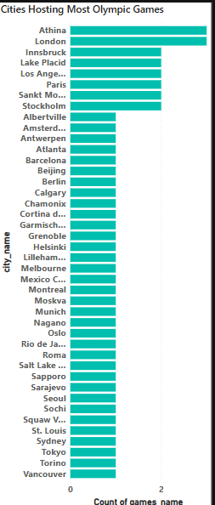
Which cities have hosted the most Olympic Games?
Conclusion :A few global cities such as London, Paris, and Tokyo have hosted the Olympics multiple times, demonstrating strong logistical capability and international reputation. Repeat hosting is often tied to economic power, historical involvement in the Games, and ability to manage large-scale international events.

Slide 13
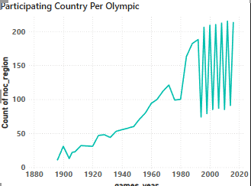
How many regions or NOCs participate in each Olympic Games?
Conclusion : The number of participating countries or NOCs has grown steadily, reflecting the Olympics' expansion into a truly global event. More nations now meet qualification standards due to improved sports access, infrastructure, and international cooperation.

Slide 14
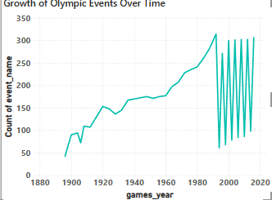
How has the number of events changed over time?
Conclusion : The number of Olympic events has grown substantially since the early 20th century. This expansion is a result of the addition of new sports, disciplines, and gender-inclusive formats. It underscores the Olympics’ adaptability and its aim to remain relevant to modern audiences.

Slide 15
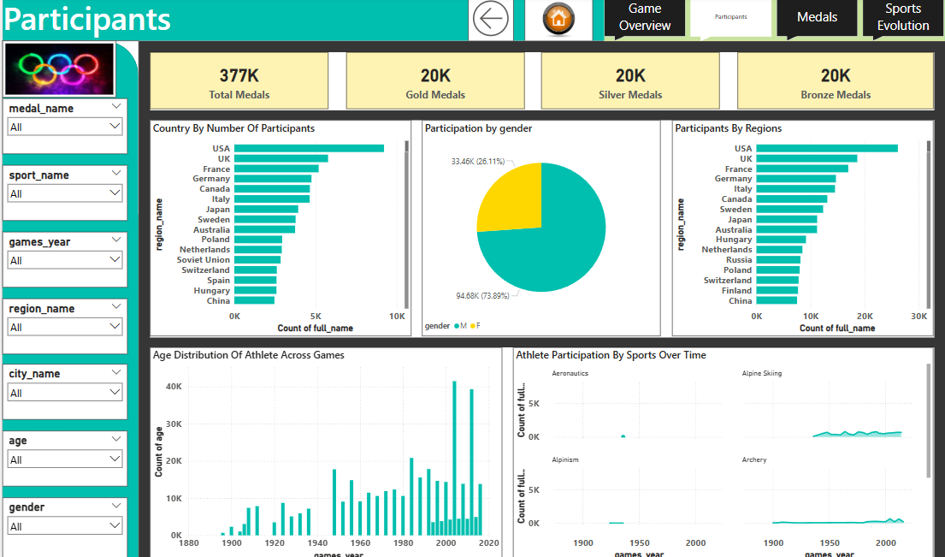

Slide 16
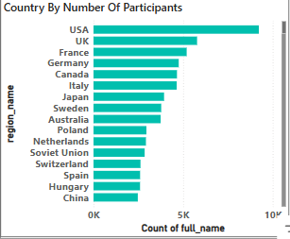
Which countries have the highest number of participants in the Olympics?
Conclusion : Countries like the United States, France, and China consistently send the most athletes. This reflects their large populations, strong sports funding, and extensive national training infrastructure. These countries also benefit from broader qualification across multiple sports categories.

Slide 17
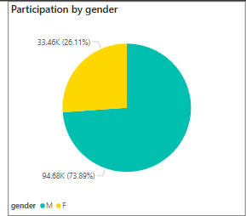
What is the distribution of participants by gender?
Conclusion : Historically, male athletes outnumbered females significantly. However, recent Games show a major shift toward gender parity. Initiatives to promote women’s sports globally and policy changes by the IOC have helped achieve near-equal representation in many recent editions.

Slide 18
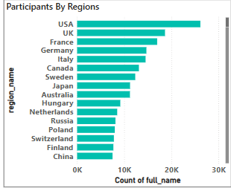
Which regions have the highest number of participants in the Olympics?
Conclusion : Regions like Europe, North America, and Asia send the highest number of athletes. This pattern aligns with population size, economic development, and investment in Olympic training. Emerging regions are slowly increasing their representation through targeted sports development.

Slide 19
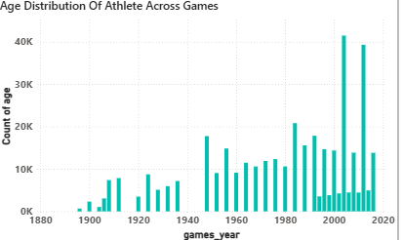
How does the age distribution of participants vary across different games?
Conclusion : Most Olympic athletes fall within the 20–30 age range, which is typically the physical peak for elite competition. Age trends vary slightly by sport, with gymnastics skewing younger and endurance sports featuring older athletes, highlighting diverse physical demands across events.

Slide 20
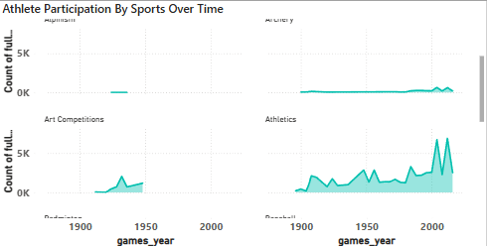
How has the participation in each sport evolved over time?
Conclusion : Athlete participation has grown steadily across most sports over time. This trend signifies increased global inclusion, sports development programs, and improved access to training and qualification pathways, especially in developing regions. New sports have also helped diversify athlete representation.

Slide 21
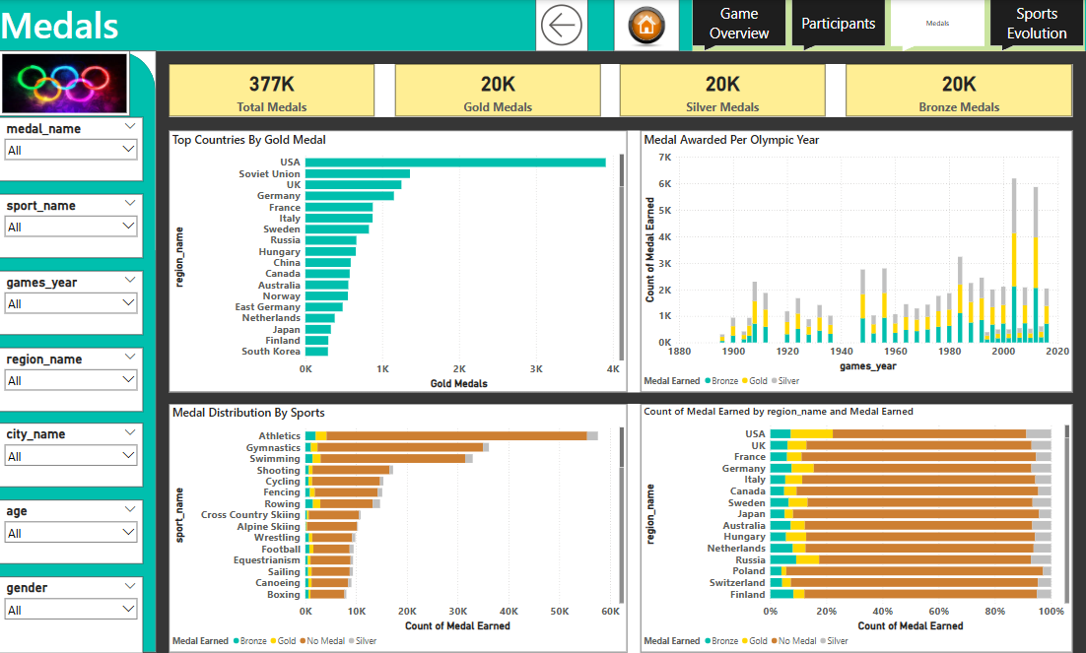

Slide 22
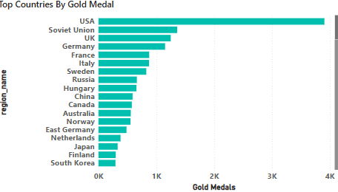
Which countries have the highest number of gold medals?
Conclusion : A small group of nations consistently dominate gold medal counts, including the USA, China, and Russia. These countries typically invest heavily in sports science, athlete development, and Olympic preparation, resulting in high-performance outcomes across multiple Games.

Slide 23
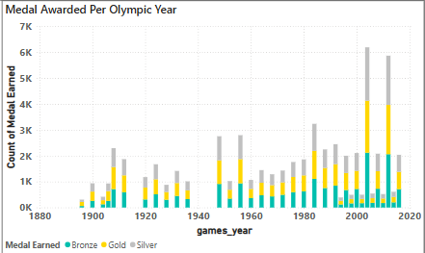
How many medals have been awarded in each Olympics?
Conclusion : The number of medals awarded has increased over time, closely linked to the rise in Olympic events and participants. More inclusive Games and the addition of new disciplines have expanded medal opportunities for athletes and nations alike.

Slide 24
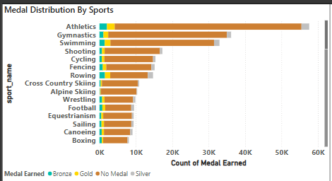
How does the medal distribution vary across different sports?
Conclusion : Sports such as Athletics, Swimming, and Gymnastics yield the highest number of medals due to their large number of events. These core Olympic sports attract global attention and offer numerous medal opportunities across various individual and team disciplines.

Slide 25
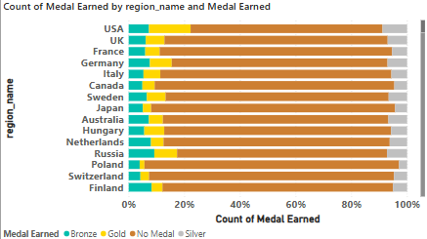
What is the distribution of medals among different regions?
Conclusion : Medals remain concentrated in regions with long-standing Olympic traditions, such as Europe and North America. However, countries from Asia and South America have increasingly broken into the medal tally, signaling a shift toward greater regional competitiveness in global sports.

Slide 26
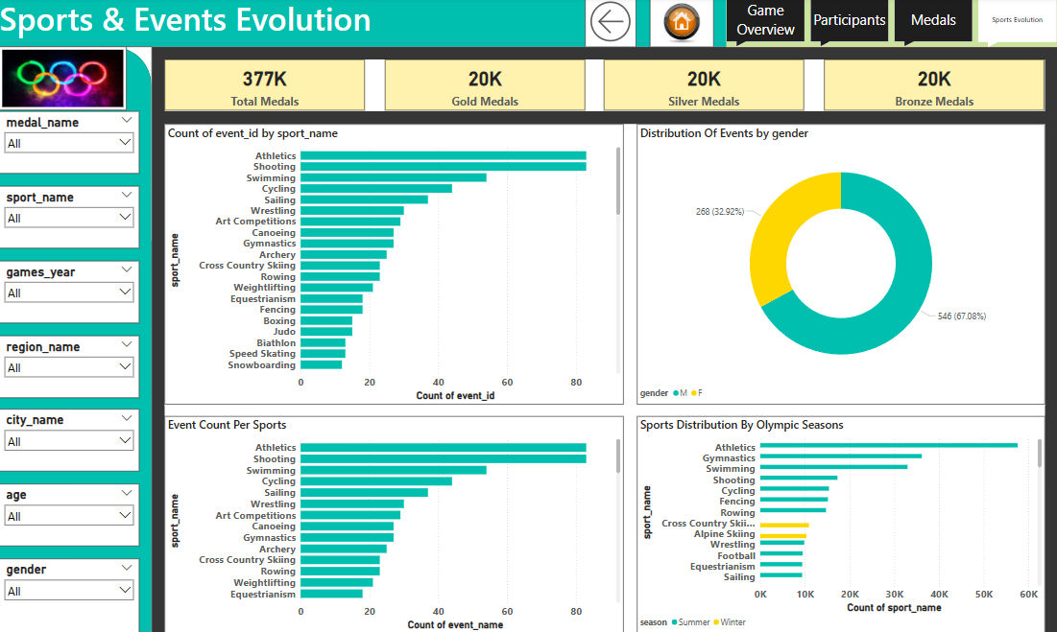

Slide 27
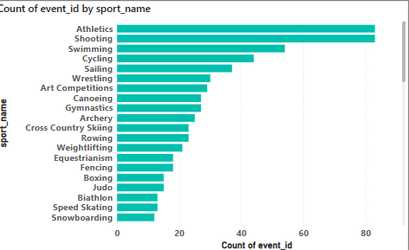
Which sports have the highest number of events in the Olympics?
Conclusion : Some sports such as Athletics, Swimming, and Gymnastics have significantly more events than others. This reflects both historical importance and a diverse range of sub-disciplines within these sports, allowing more athletes and countries to compete in different formats.

Slide 28
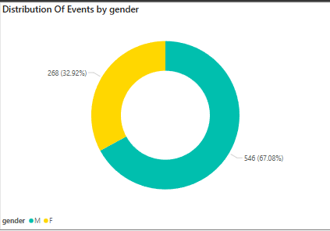
What is the distribution of events by gender (Men, Women, Mixed)?
Conclusion : There has been a notable shift toward gender balance in Olympic events. While men dominated historically, recent Games have introduced more women’s and mixed events, showing the IOC’s commitment to promoting equality and inclusivity across sports disciplines.

Slide 29
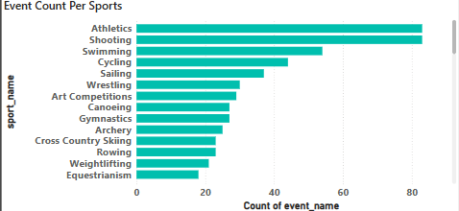
How many events are there in each sport?
Conclusion : Some sports such as Athletics, Swimming, and Gymnastics have significantly more events than others. This reflects both historical importance and a diverse range of sub-disciplines within these sports, allowing more athletes and countries to compete in different formats.

Slide 30
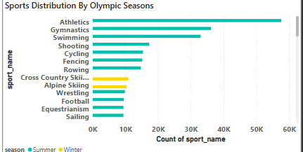
What is the distribution of sports between Summer and Winter Olympics?
Conclusion : The number of sports in the Summer Olympics far exceeds that of the Winter Games. This is largely due to the broader appeal and accessibility of summer sports worldwide, as well as climate limitations restricting the reach and variety of winter sports.

Slide 31
Excel Dashboard

Slide 32
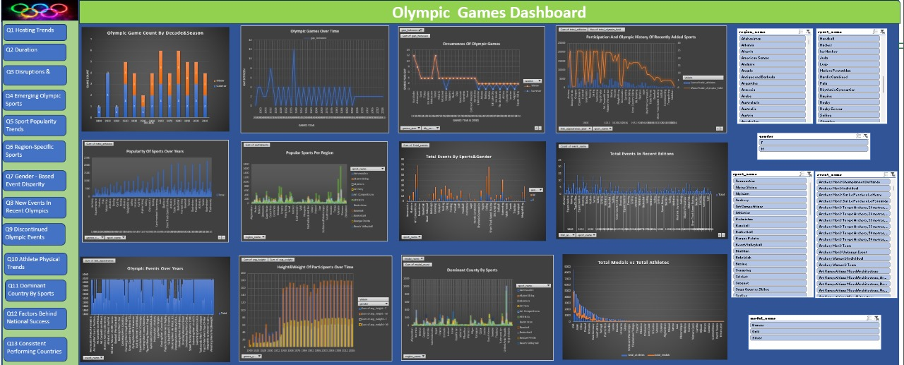
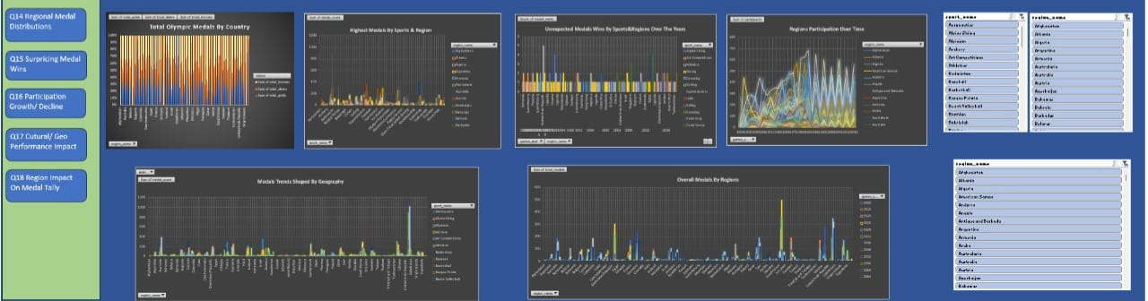

Slide 33
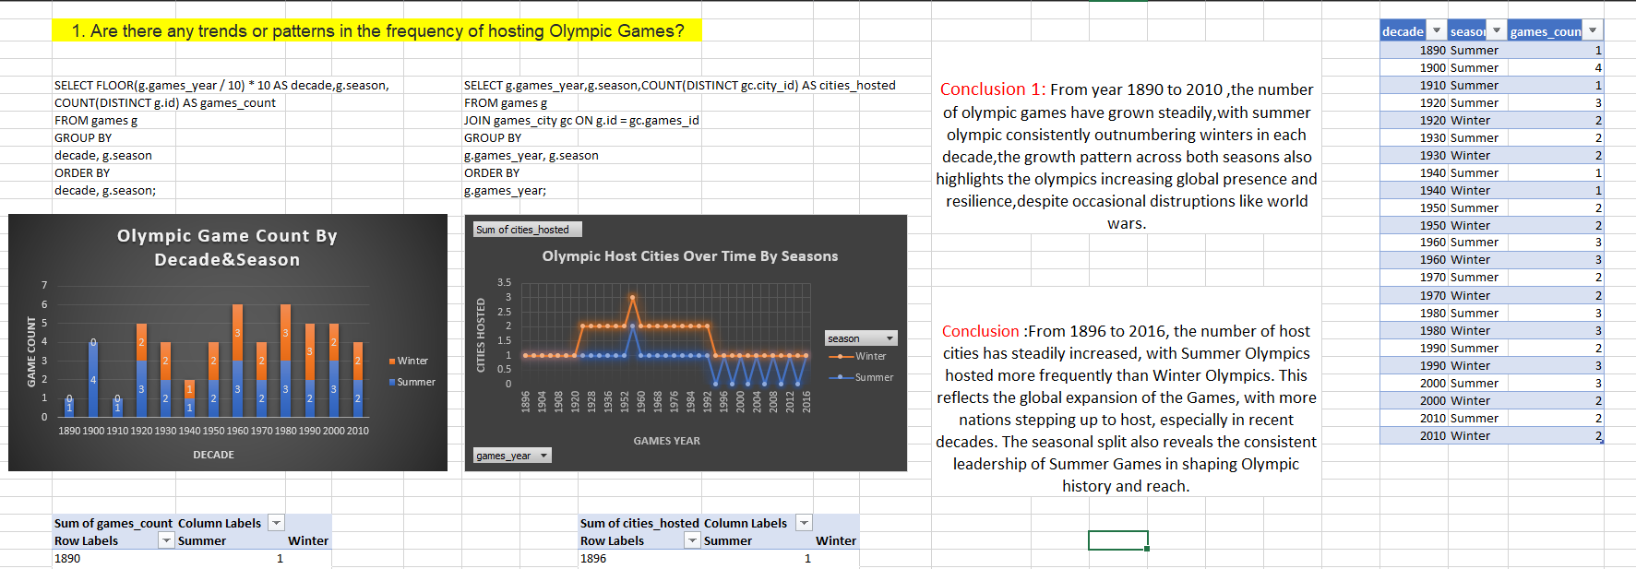

Slide 34
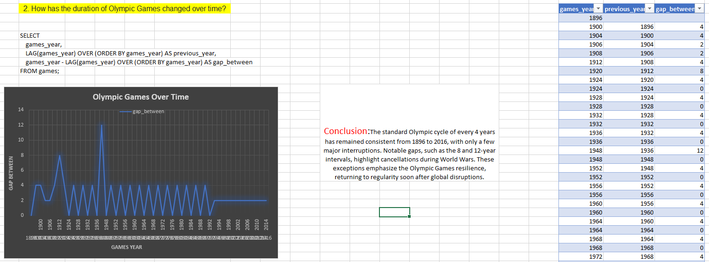

Slide 35
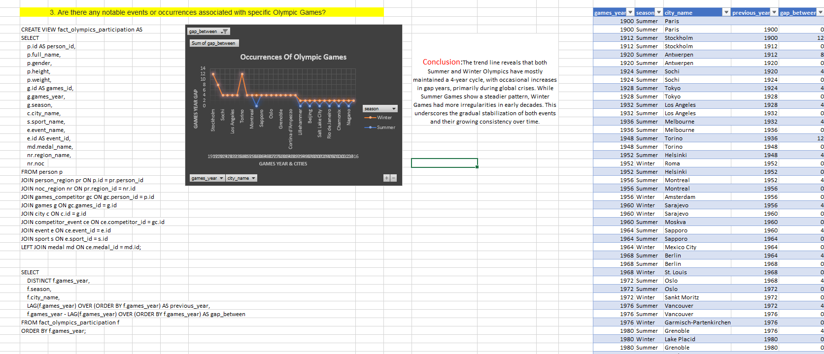

Slide 36
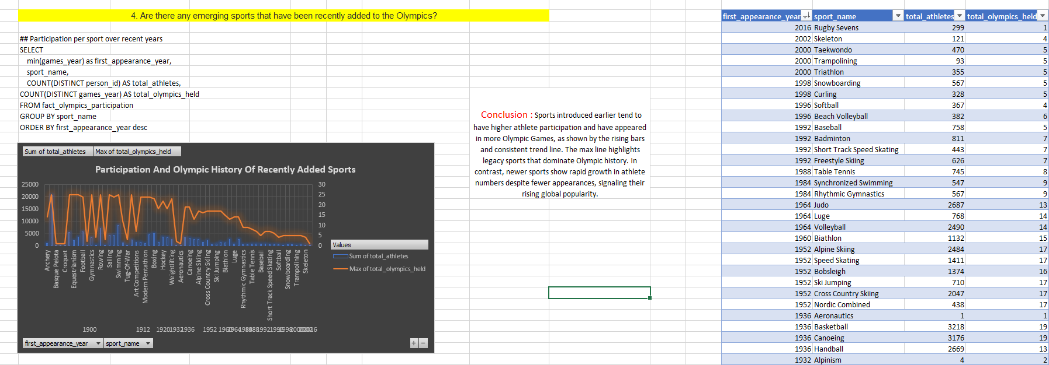

Slide 37
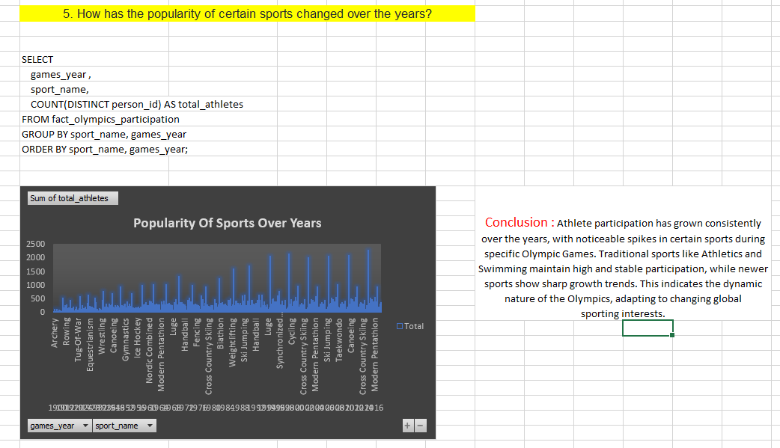

Slide 38
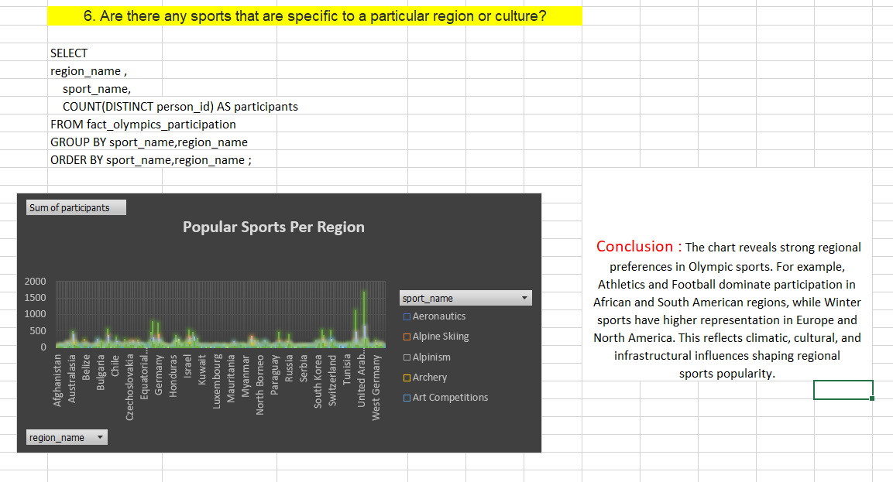

Slide 39
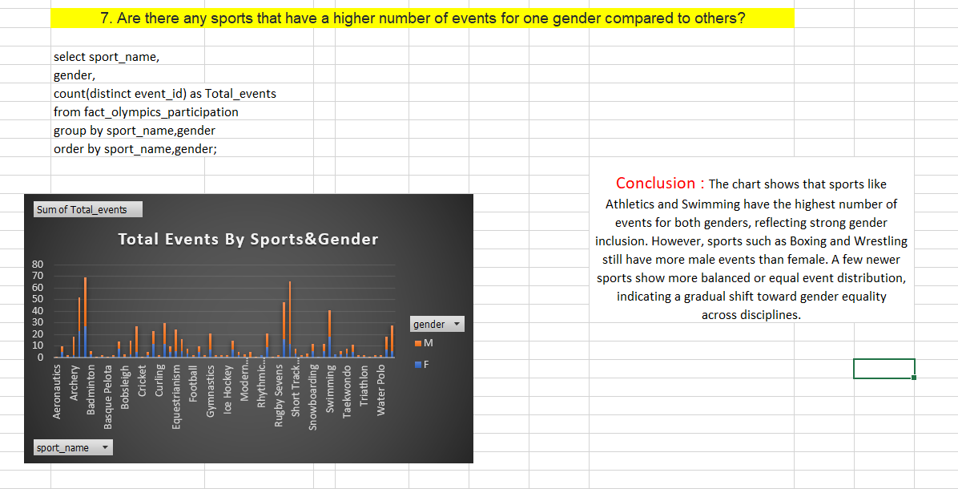

Slide 40
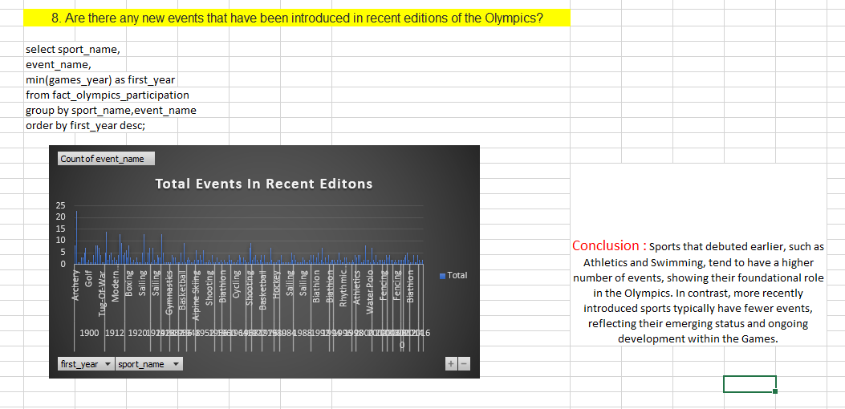

Slide 41
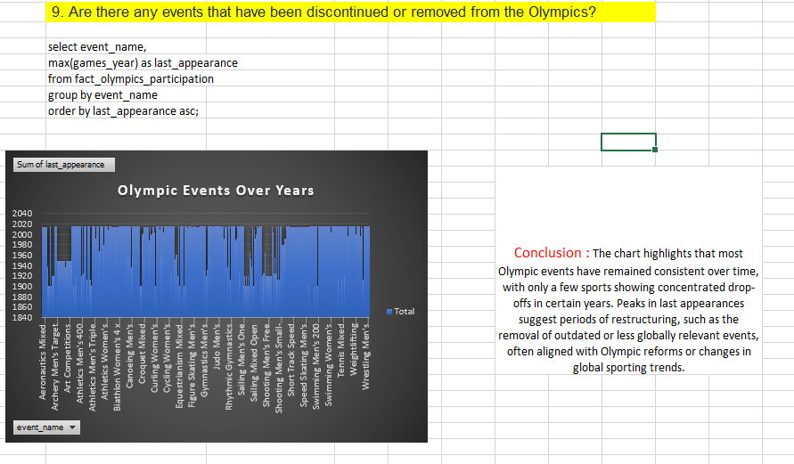

Slide 42
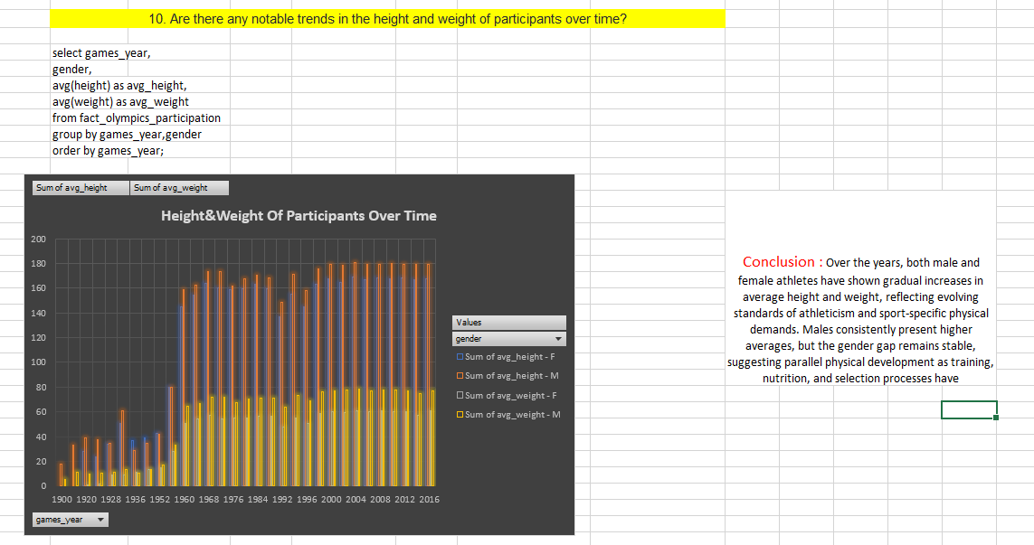

Slide 43
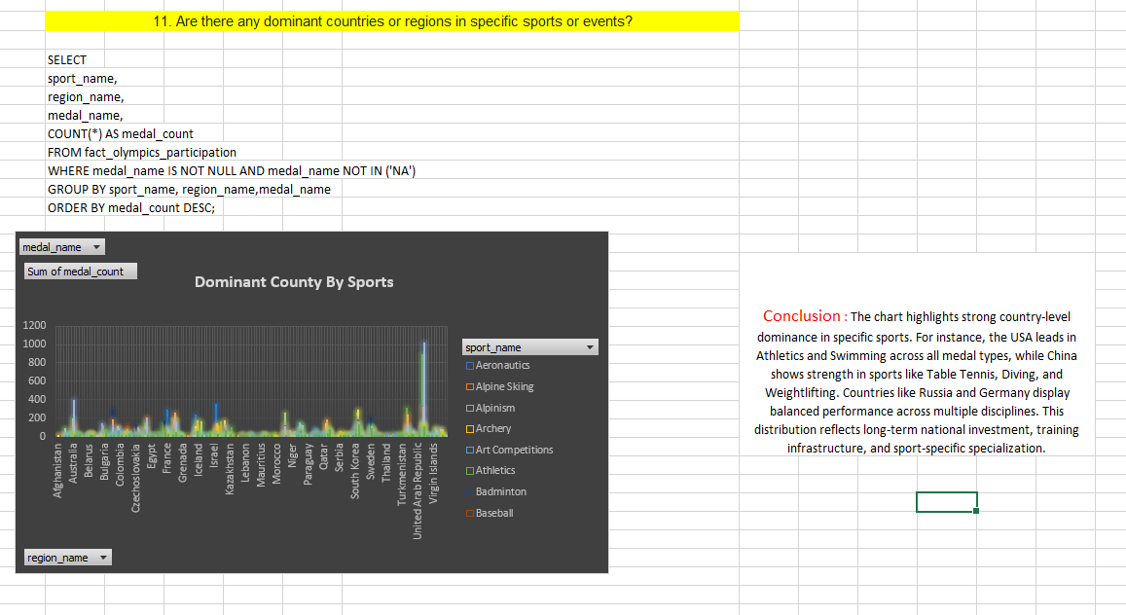

Slide 44
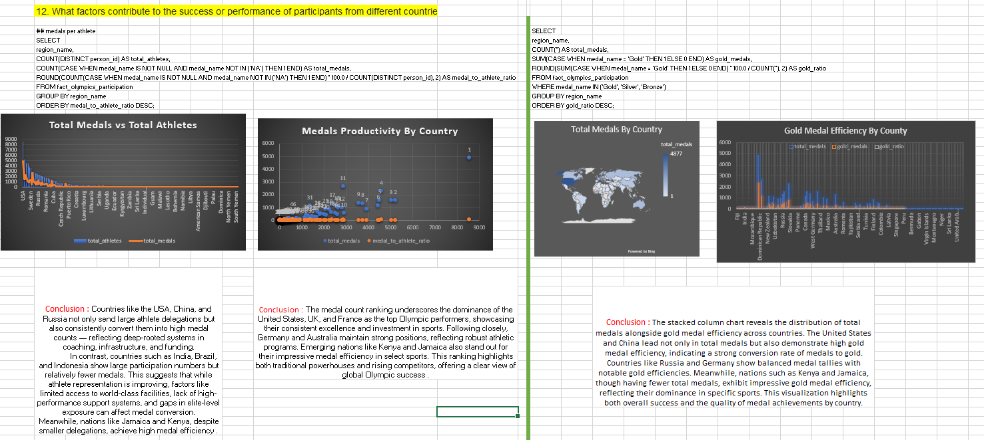

Slide 45
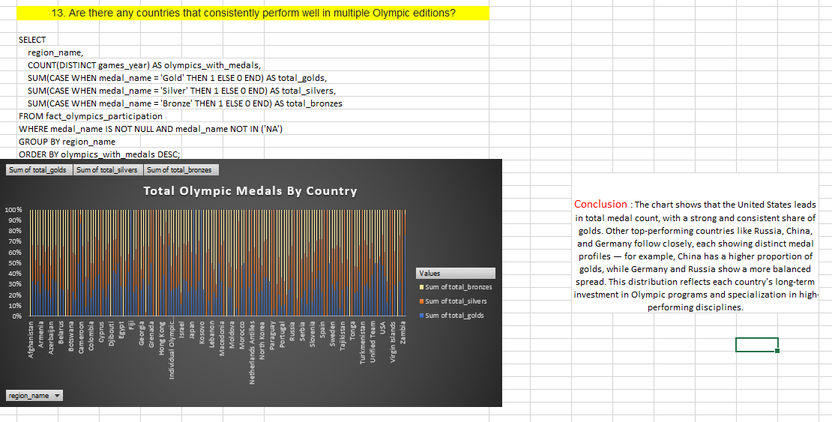

Slide 46
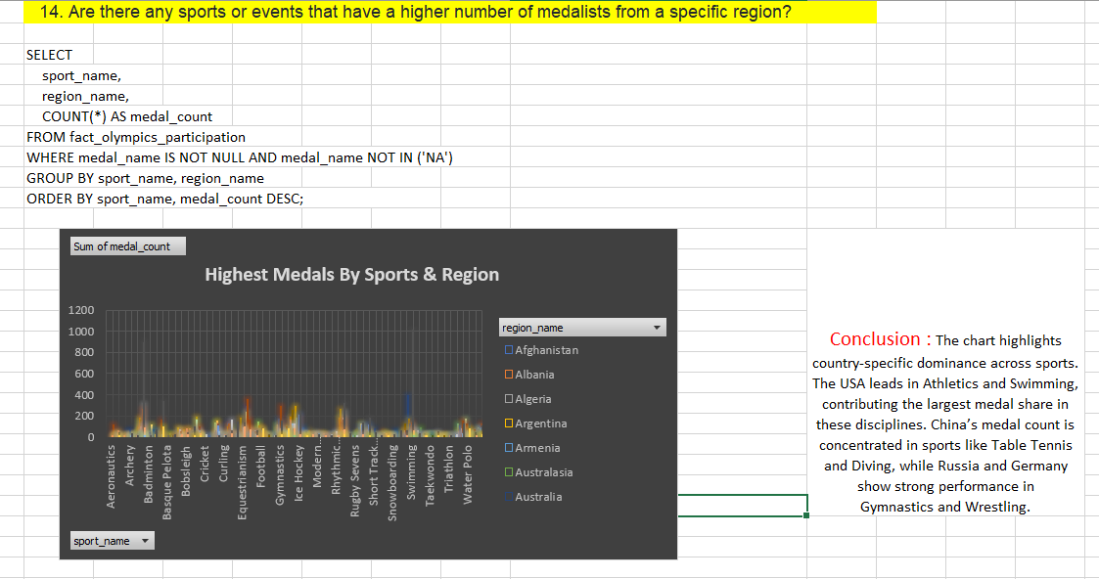

Slide 47
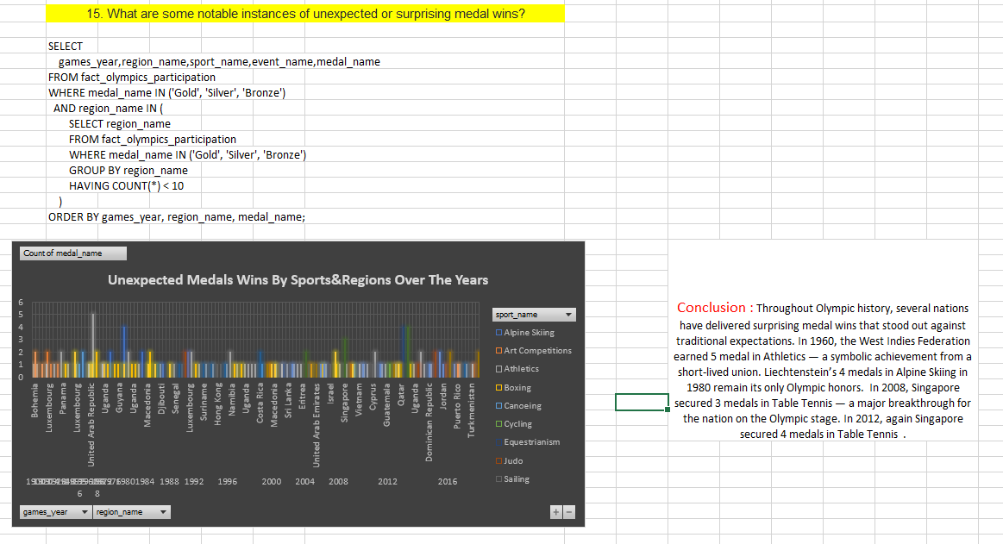

Slide 48
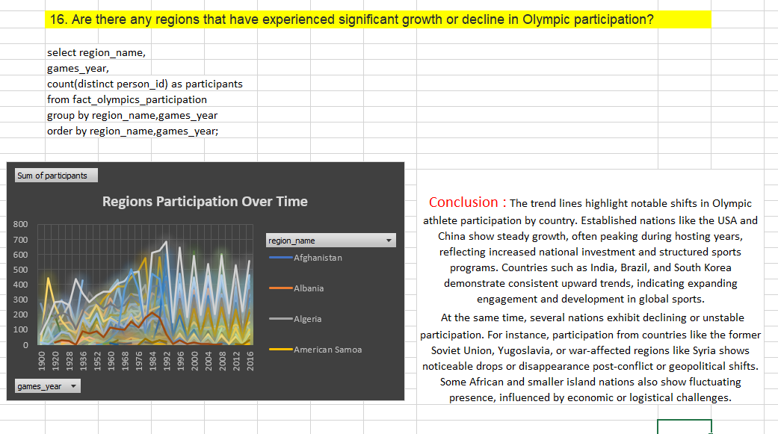

Slide 49
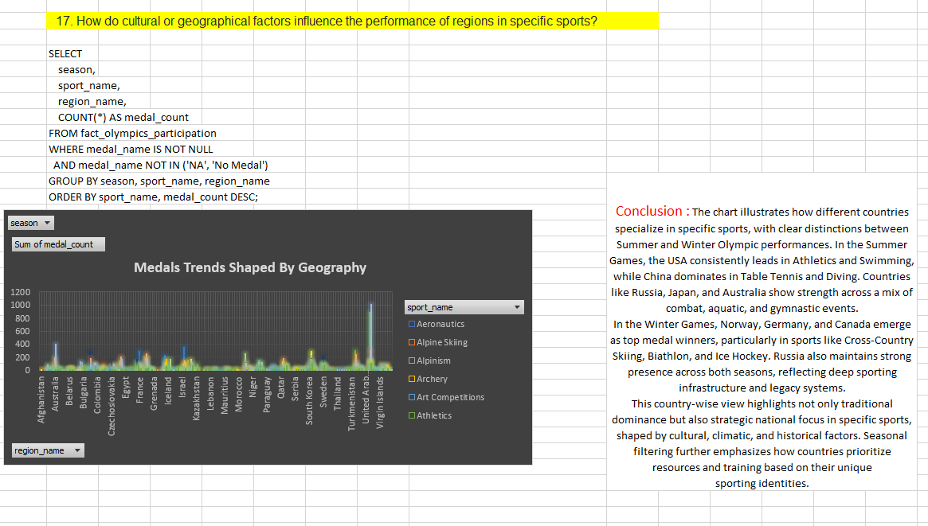

Slide 50
